Slide 1
Unit 5 Three Dimensional Graphics LH 1

Slide 2
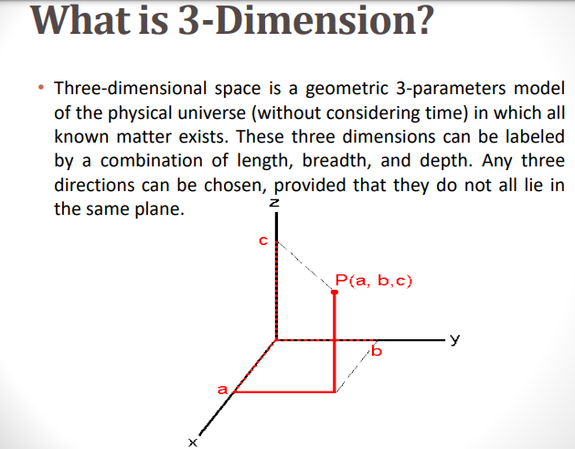

Slide 3
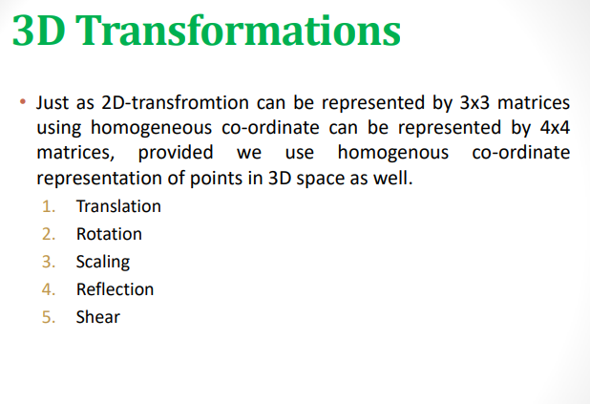

Slide 4
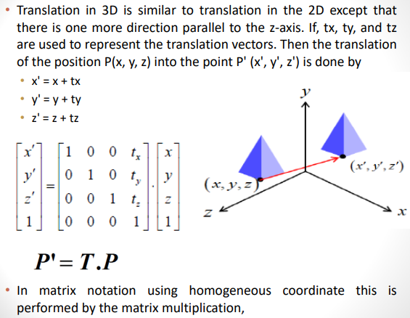
1. Translation

Slide 5
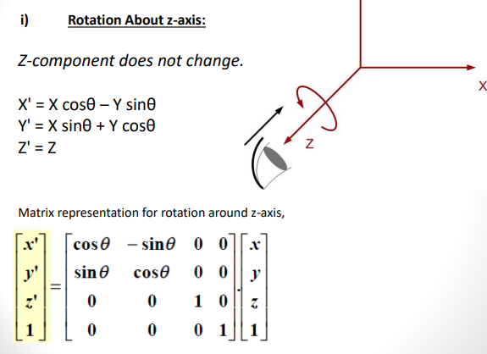
2. Rotation y

Slide 6
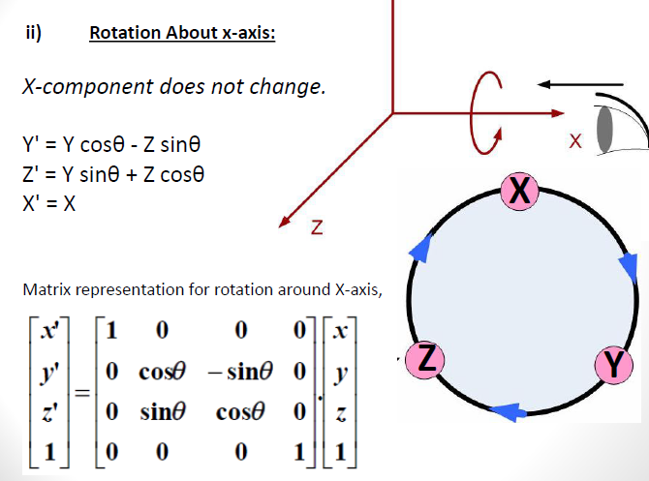
y

Slide 7
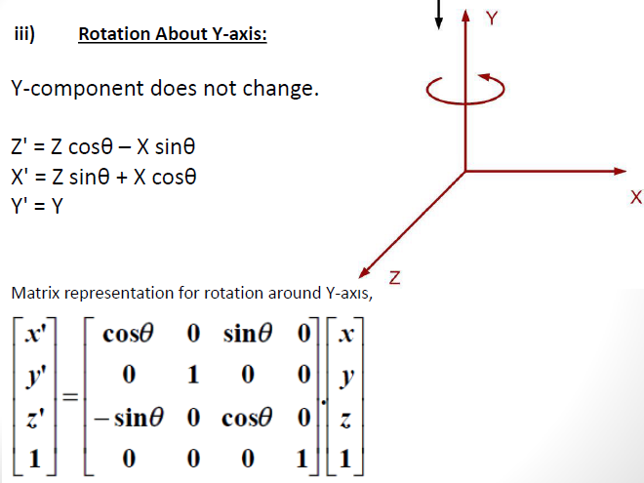

Slide 8
Q1. Rotate an object ABCD with coordinates A(0,0,0),B (3,0,0), C(3,3,0) and D(0,3,0) about x axis with rotation angle 45 degree.

Slide 9
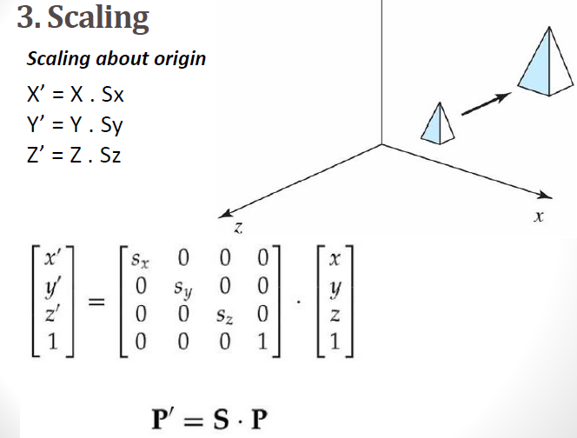
y

Slide 10
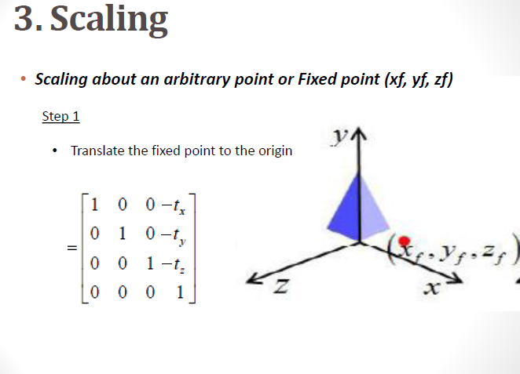

Slide 11
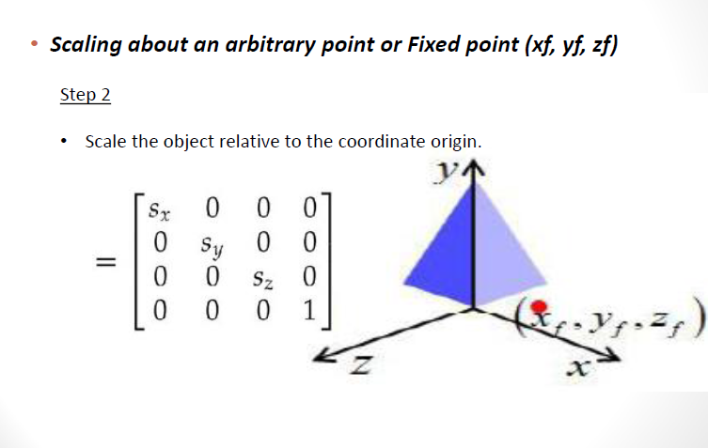

Slide 12
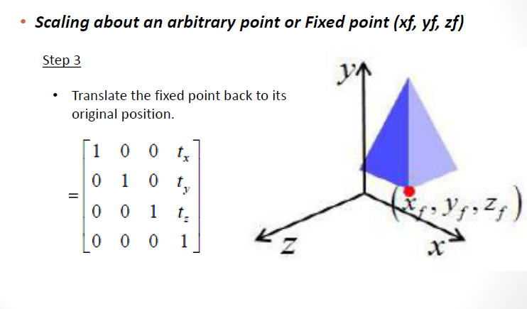

Slide 13
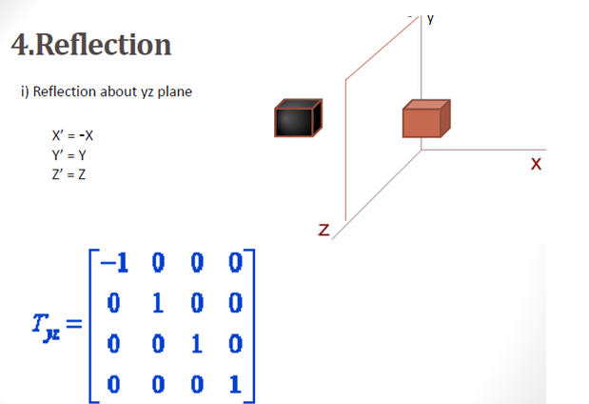

Slide 14
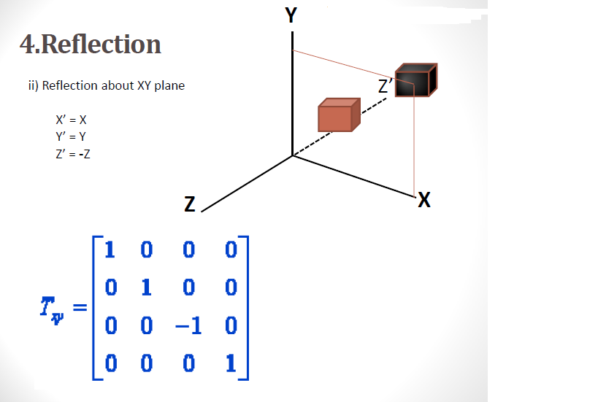

Slide 15
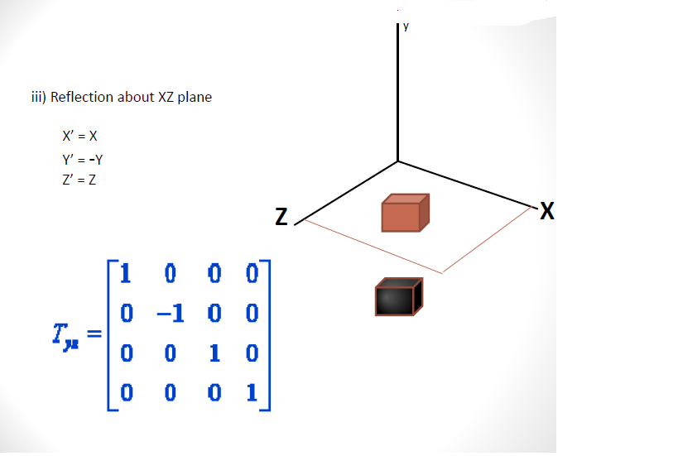

Slide 16
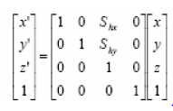
5.Shear
Shearing transformations can be used to modify object shapes.
Z-axis Shear
•This transformation alters x- and y-coordinate values by an amount that is proportional to the z value, while leaving the z coordinate unchanged, i.e,
x' = x + Shx .z
y '= y + Shy .z
z' = z

Slide 17
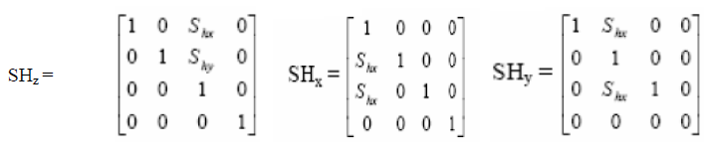
Similarly, we can find X-axis shear and Y-axis shear. Similarly,
X axis shear is, x’=x Y’= y+Shy.x, z’= z+Shz.xs
Y axis shear is y’=y, x’= x+Shx.y, z’= z+Shy.x

Slide 18
Polygon Surfaces
The most commonly used boundary representation for a three-dimensional graphics object is a set of surface polygons that enclose the object interior.
Many graphics systems store all object descriptions as sets of surface polygons.
For this reason, polygon descriptions are often referred to as “standard graphics objects”.
Generally polygon surfaces are specified using;
1.Polygon Table
2.Plane Equations
3.Polygon Meshes.

Slide 19
1. Polygon Tables
Polygons tables can be used to specify polygon surfaces.
We specify a polygon surface with a set of vertex coordinates and associated attribute parameters.
Polygon tables can be organized into two groups:
1.Geometric tables
2.Attribute tables
1.Geometric data tables: Contain vertex coordinates and parameters to identify the spatial orientation of the polygon surfaces.
2.Attribute tables: Provide information for an object and includes parameters specifying the degree of transparency of the object and its surface reflectivity and texture characteristics.

Slide 20
Geometric data consists of three tables: a vertex table, an edge table, and a surface table.
•Vertex table:
•Edge Table:
•Surface table:

Slide 21
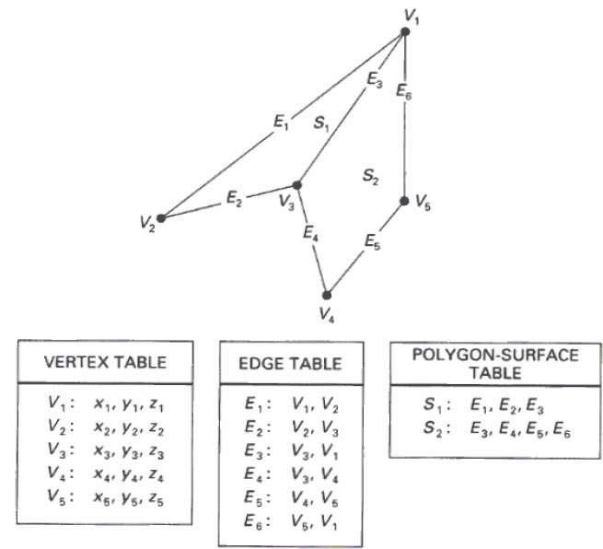
Polygon Tables

Slide 22
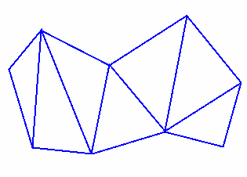
2. Polygon Meshes
A polygon mesh is a collection of vertices, edges and surfaces that defines the shape of a polyhedral object in 3D computer graphics
1. Triangular Mesh :
It produces n – 2 connected triangles, given the coordinates for n vertices.

Slide 23
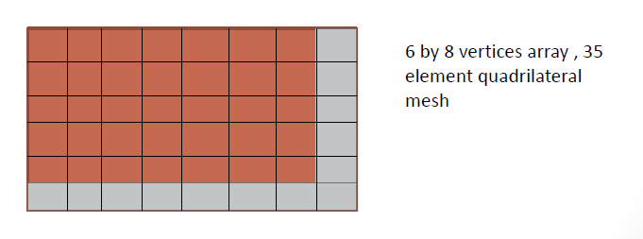
Quadrilateral Mesh
Another similar functions the quadrilateral mesh that generates a mesh of (n-1)(m-1) quadrilaterals, given the coordinates for an n by m array of vertices

Slide 24
